Slide 1
SageMaker Automatic Model Tuning

Slide 2
Part 1: Theory

Slide 3
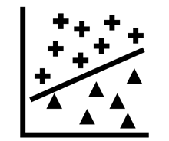
Many hyperparameters for training
Model:
Number of layers: 1, 2, 3, …
Activation functions: Sigmoid, tanh, RELU, …
Optimization:
Method: SGD, Adam, AdaGrad, …
Learning Rate: 0.01 to 2
Data:
Batch Size: 8, 16, 32 …
Augmentation: Resize, Normalize, Color Jitter, …
Notes:
Various data types: Continuous, Integer, Categorical
Various ranges

Slide 4


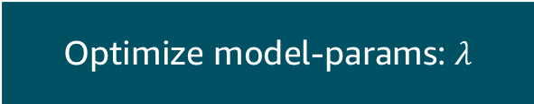

Choose function to optimize
Optimize model-params: $λ$
Optimize hyper-params: $θ$
$$\min_{λ}{f(λ|θ)}$$
$$\min_{θ}{h(θ)}$$
Notes:
$f$ and $h$ return the loss: cross entropy loss.
Can find gradient of $λ$: 1st order.
Can’t find gradient of $θ$: 0th order. Often no closed form.

Slide 5
Grid Search
Sigmoid
Activation
RELU
tanh
0
0.5
1
1.5
2
Learning Rate
Notes:
Underlying true relationship is hidden.
Cost time and money to evaluate.
Must sample.

Slide 6
Grid Search
Sigmoid
Activation
RELU
tanh
0
0.5
1
1.5
2
Learning Rate
Notes:
Discretize

Slide 7
Grid Search
Assume each hyper-param has 5 options
e.g. Learning Rate: 0, 0.5, 1, 1.5, 2
1 HP = 5 combinations
2 HPs = 5*5 = 25 combinations
3 HPs = 5*5*5 = 125 combinations
…
10 HPs = 5^10 = 9,765,625 combinations
N HPs = 5^N combinations
Notes:
1000 years for model that takes 1h to train

Slide 8
Grid Search
Sigmoid
Activation
RELU
tanh
0
0.5
1
1.5
2
Learning Rate
Notes:
Often some hyper-params more important than others.

Slide 9
Grid Search
Sigmoid
Activation
RELU
tanh
0
0.5
1
1.5
2
Learning Rate
Notes:
Wasted compute.

Slide 10
Random Grid Search
Sigmoid
Activation
RELU
tanh
0
0.5
1
1.5
2
Learning Rate
Notes:
Can limit number of samples

Slide 11

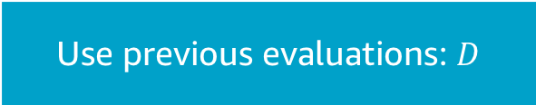

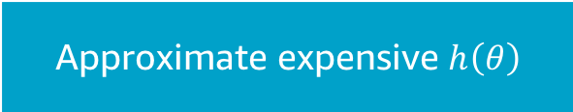
Create model of model loss
Approximate expensive $h\left(θ\right)$
Use previous evaluations: $D$
$$h\left(θ\right) ≈h′(θ)$$
$$h′(θ|D)$$
Notes:
Update meta-model using data: i.e. Bayesian
Similar to training model.

Slide 12




Use model of model loss
$$h\left(θ\right): true (hidden)$$
$$D: samples$$
Activation
RELU
$$h^{′}\left(θ\right):approximate$$
$$c: candidate$$
0
0.5
1
1.5
2
Learning Rate
Notes:
Use quick model to choose next point to evaluate.
Use acquisition function to choose next point.

Slide 13
Gaussian Process for model of model loss
Notes:
Assumes similar points give similar results: Co-variance function.
Gives probabilistic estimates.
Closed form expressions for mean and variance.

Slide 14

Gaussian Process
$${f(X}_{t_{1}}),f(X_{t_{2}}), …, f(X_{t_{n}})\sim 𝒩(μ, Σ)$$
Notes:
Assumes similar points give similar results: Co-variance function.
Gives probabilistic estimates.
Can get closed form expressions for mean and variance (for specific covariance functions).
Can be viewed as a distribution of functions.

Slide 15
Gaussian Process for model of model loss

Slide 16
Gaussian Process for model of model loss

Slide 17
Gaussian Process for model of model loss
Notes:
Single sample of a function

Slide 18
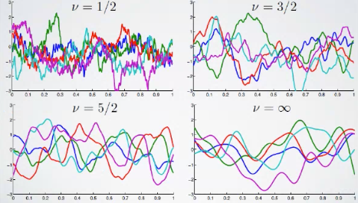

Covariance Matrix
Similarity between 2 points: controls ‘smoothness’.
SageMaker uses Matérn kernel with $υ=5/2$
Notes:
Most common is Squared Exponential Kernel (Gaussian radial basis function). Matérn generalizes this.
V=Inf gives Squared Exponential Kernel, Infinitely differentiable.
V=5/2 Can differentiate twice but not 3 times) – good default, works on wide range of problems, robust
Simplifications for these cases.

Slide 19
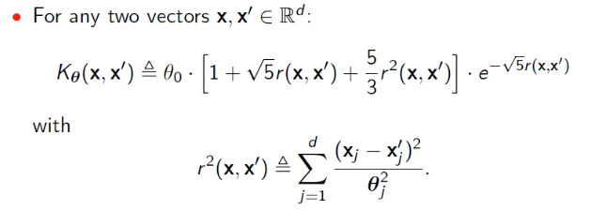
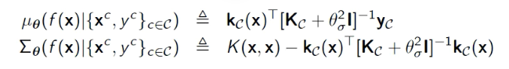
Closed form expressions
Notes:
Theta is the bandwidth <- controls which parameters are more important than others.
Matrix inversions which are cubic complexity.
Inversion scale with to number of candidate points evaluated.

Slide 20
Acquisition Function
Given posterior distribution of functions…
Used as criteria for selecting next candidate hyperparams for evaluation.
Often depends on the best hyperparams seen so far in search.
Controls exploration vs exploitation in search.

Slide 21
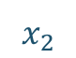
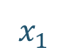
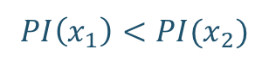
Acquisition Function: Probability of Improvement
$$PI\left(x_{1}\right)<PI(x_{2})$$
70%
50%
70%
Current best
$$x_{2}$$
$$x_{1}$$
Notes:
Can calculate because model is probabilistic.
“Probability that you’ll do better than best point seen so far.”
Ignores scale

Slide 22
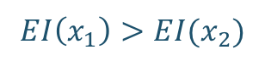
Acquisition Function: Expected Improvement
$$EI\left(x_{1}\right)>EI(x_{2})$$
70%
1
0.3
0.2
Current best
$$x_{2}$$
-1
$$x_{1}$$
Notes:
Adds scale.
Good balance of exploration and exploitation.
Exploitation when mean is high.
Exploration when variance is high.
Used as default in SageMaker AMT.

Slide 23
Using Acquisition Functions
Notes:
Start at t=2.

Slide 24
Using Acquisition Functions

Slide 25
Add parallelism with Thompson Sampling
Notes:
Sample function and take maximum.
Local refinement with Expected Improvement.
At least 10 Bayesian steps, so no more than 10% of total budget for single parallel run.

Slide 26

Input Mapping
Create a unit hypercube from all input hyperparameters
Continuous – e.g. learning rate
$$\left[0,2\right]→[0,1]$$
Integral – e.g. number of epochs
$$\left\{1,2,…,50\right\}→[0,1]$$
Categorical – e.g. type of activation
$$\left\{Sigmoid, RELU, tanh\right\}→{\left[0,1\right]}^{3}$$
Notes:
One-hot encode for categorical.
5 dimensional hypercube

Slide 27
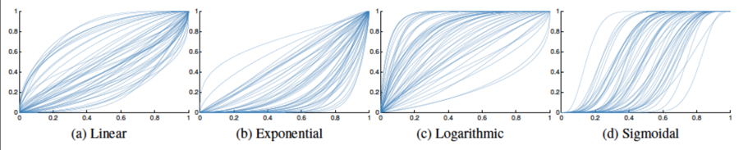
Input Warping
Apply transformation of variables within the hypercube.
Automatic selection of transform per variable from Beta CDF:
e.g. for learning rate
{0.3, 0.6, 0.9} less effective search space than
{0.01, 0.1, 1} (i.e. log transform)

Slide 28
Part 2: Practical

